Slide 1
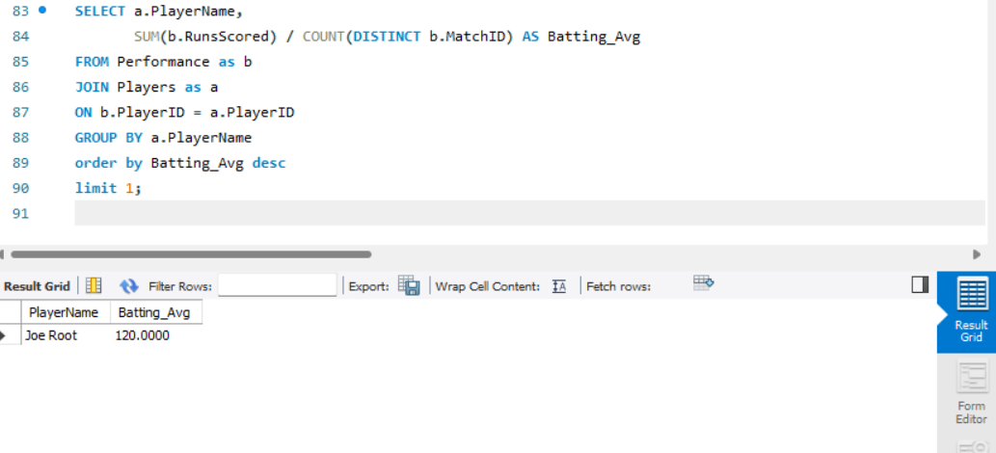
Q1.
ANSWER-1.
Explanation:
• The batting average is total runs scored / matches played.
• We use SUM(RunsScored) for total runs and COUNT(DISTINCT MatchID) to count unique matches.
• The result is sorted in descending order to find the highest batting average.

Slide 2
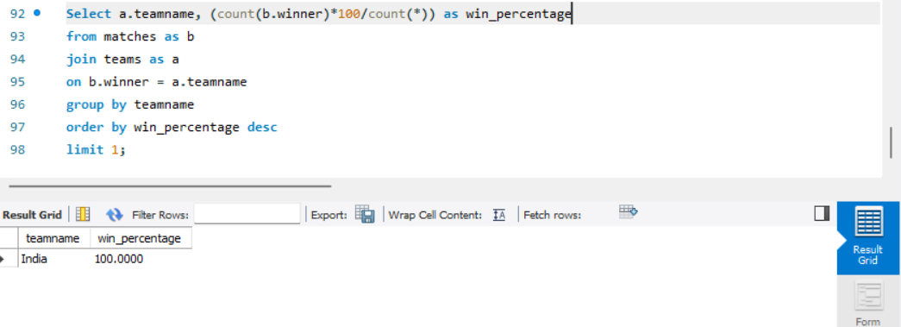
Q2.
ANSWER 2.
Explanation:
• Win_percentage = (matches won / total matches) × 100.
• We count how many times each team appears as the Winner in the Matches table.
• The result is ordered to find the highest percentage.

Slide 3
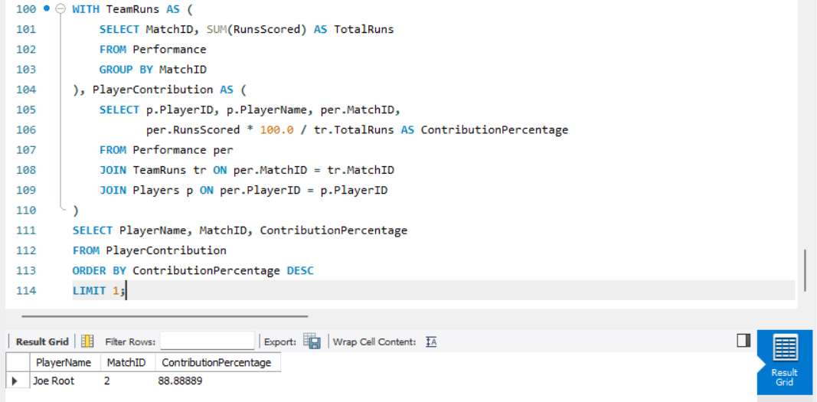
Q3.
ANSWER 3.
Explanation:
• We first calculate total team runs per match.
• Then, we find each player’s contribution percentage in that match.
• The highest percentage is retrieved.

Slide 4
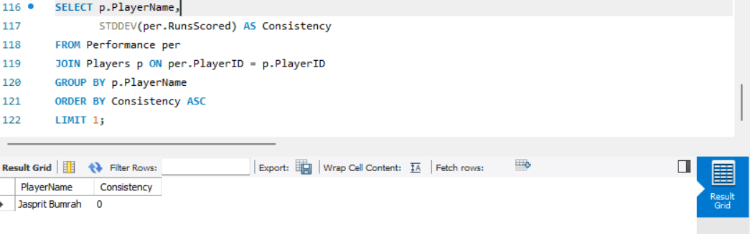
Q4.
ANSWER 4.
Explanation:
• Standard deviation (STDDEV()) measures consistency. Lower values mean less variation.
• Sorting in ascending order finds the most consistent player.

Slide 5
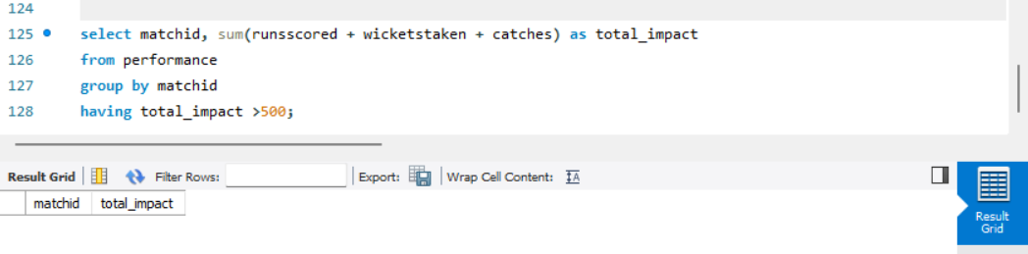
Q5.
ANSWER-5.
Explanation:
• Calculates total impact as a sum of runs, wickets, and catches.
• Uses HAVING to filter matches where this sum is greater than 500.

Slide 6
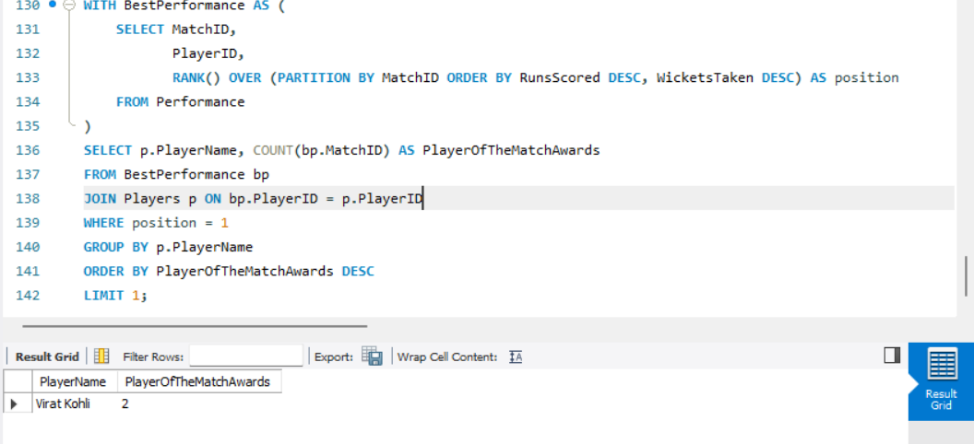
Q6.
ANSWER-6.
Explanation:
• We rank players per match by highest runs scored and then wickets taken.
• The top-ranked player per match is counted to determine the most awards.

Slide 7
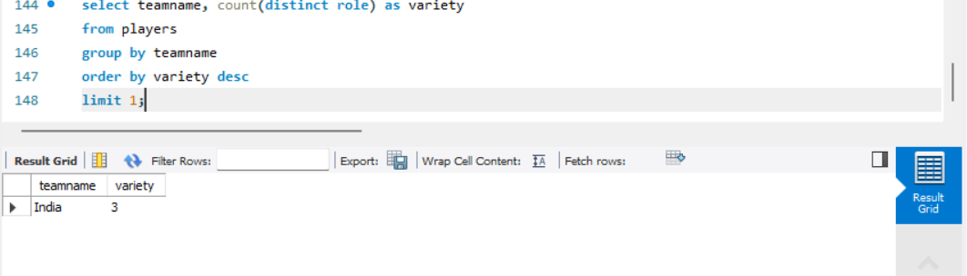
Q7.
ANSWER-7.
Explanation:
• Counts distinct roles within each team.
• The team with the highest count has the most diverse squad.

Slide 8
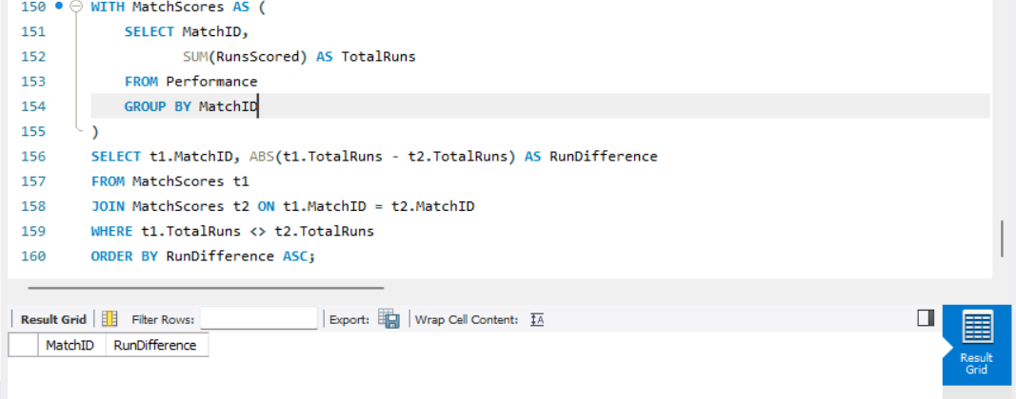
Q8.
ANSWER-8.
Explanation:
• Finds matches where the total runs by both teams differ.
• Uses ABS() to calculate the absolute run difference and sorts in ascending order.

Slide 9
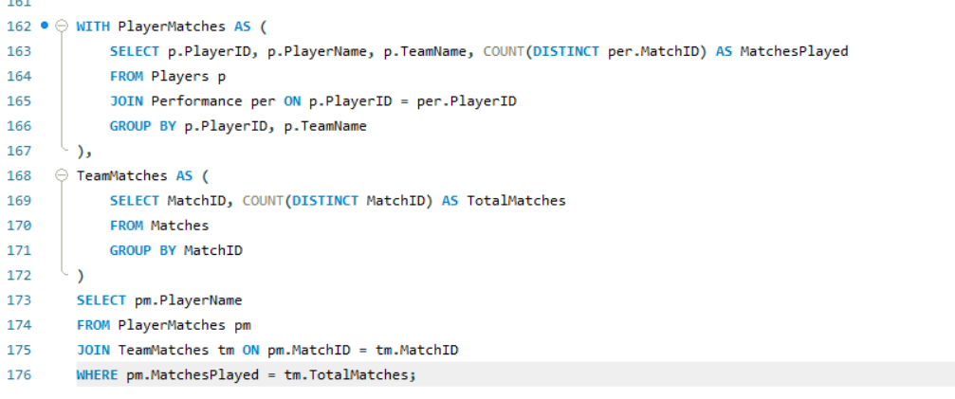
Q9.
ANSWER-9.
Explanation:
• Counts matches per player and matches per team.
• Players who played all their team’s matches are selected.

Slide 10
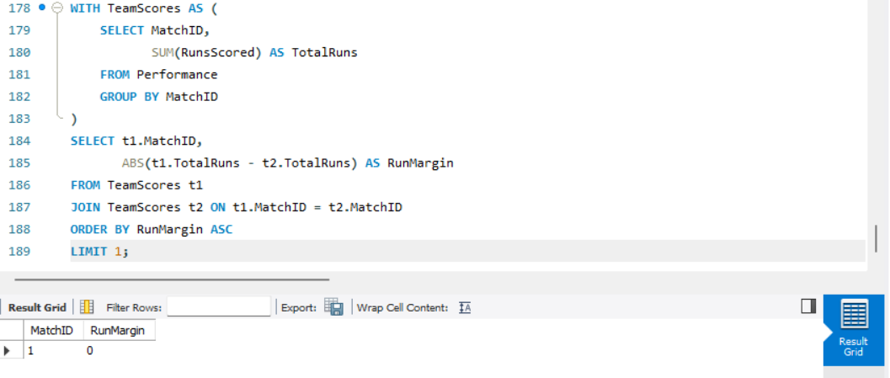
Q10.
ANSWER-10.
Explanation:
• Calculates the absolute run margin between two teams in a match.
• The match with the smallest margin is identified.

Slide 11
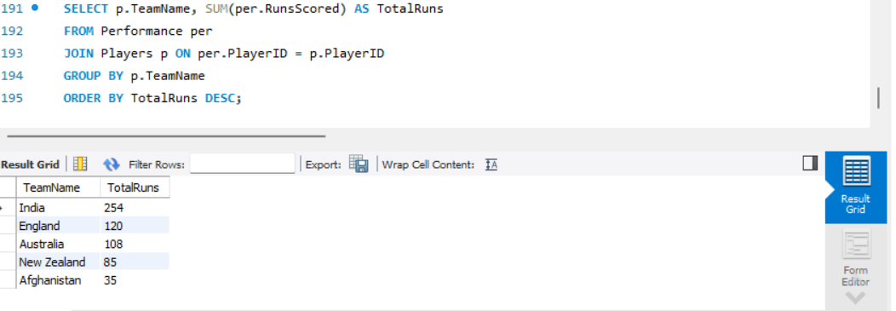
Q11.
ANSWER-11.
Explanation:
• Sums up runs scored by players, grouped by team.

Slide 12
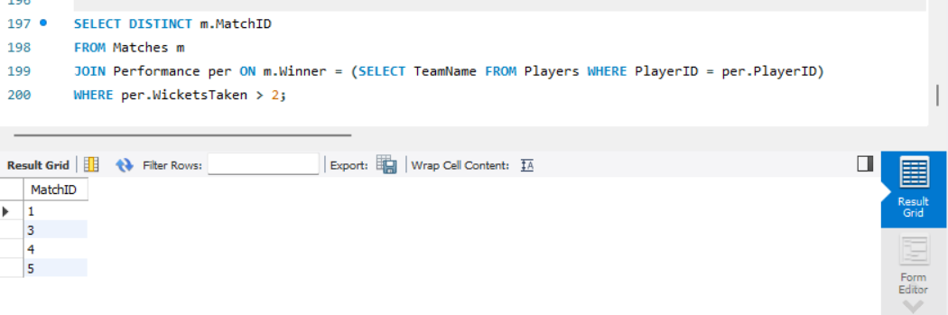
Q12.
ANSWER-12.
Explanation:
• Finds matches where a player from the winning team took more than 2 wickets.

Slide 13
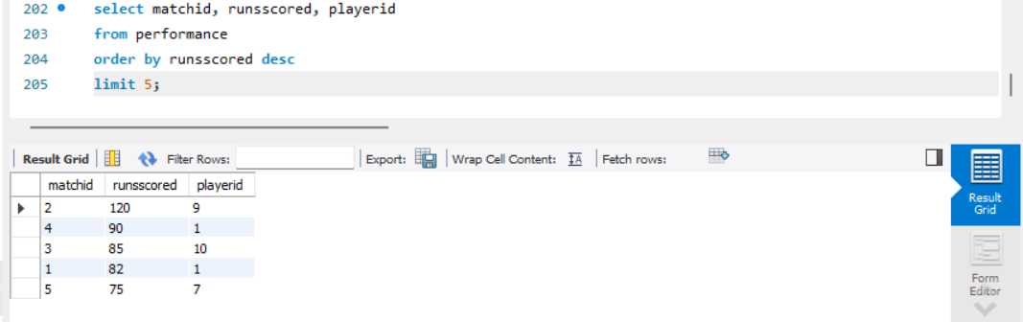
Q13.
ANSWER-13.
Explanation:
• Retrieves the top 5 highest scores in a match.

Slide 14
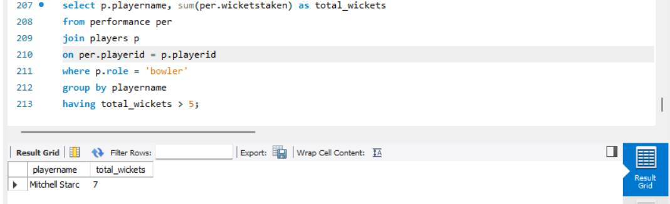
Q14.
ANSWER-14.
Explanation:
• Filters bowlers who have taken at least 5 wickets.

Slide 15
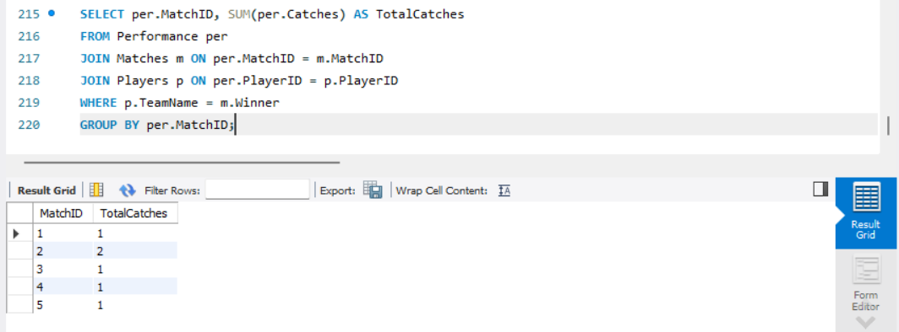
Q15.
ANSWER-15.
Explanation:
• Calculates total catches by players from the winning team in each match.

Slide 16
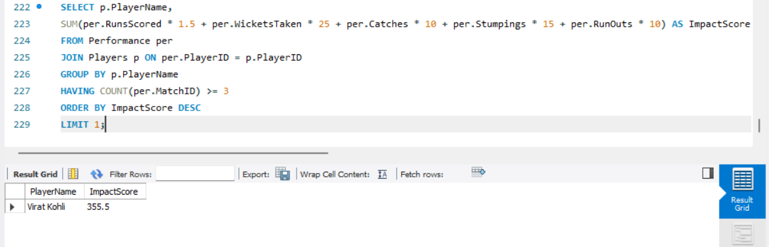
Q16.
ANSWER-16.
Explanation:
• Computes impact score using the given formula.
• Considers only players with at least 3 matches.

Slide 17
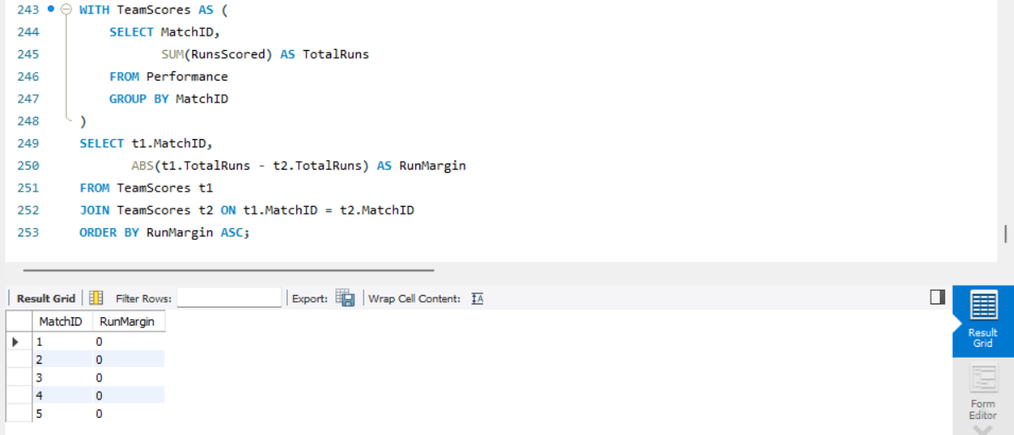
Q17.
ANSWER-17.
Explanation:
• Calculates the absolute run margin between two teams in a match.
• The match with the smallest margin is identified.

Slide 18
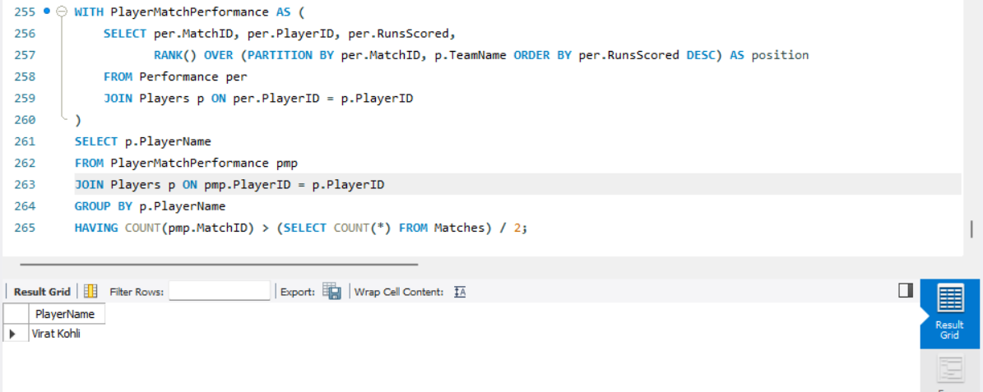
Q18.
ANSWER-18.
Explanation:
• Finds players who were top scorers in more than half of their matches.

Slide 19
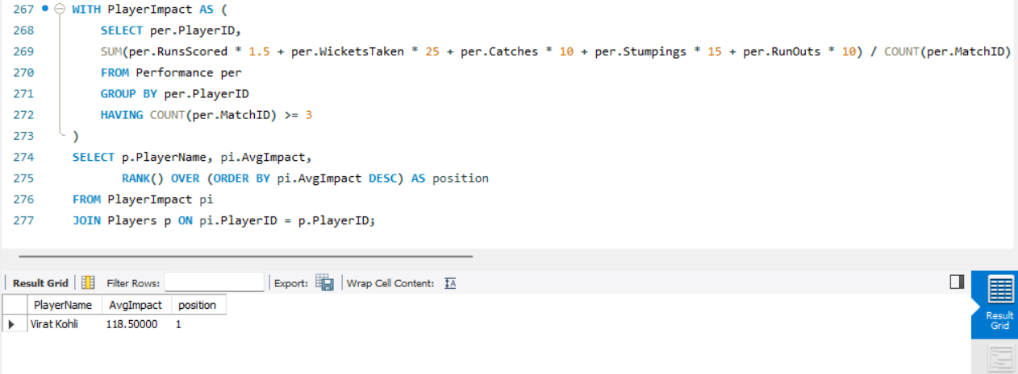
Q19.
ANSWER-19.
Explanation:
• Computes average impact per match and ranks players.

Slide 20
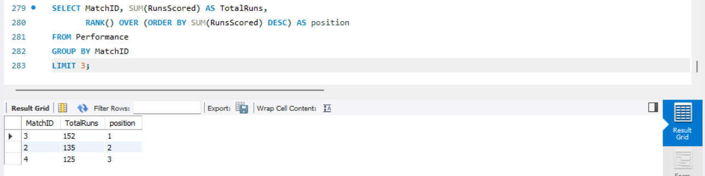
Q20.
ANSWER-20.
Explanation:
• Ranks matches based on total runs scored.

Slide 21
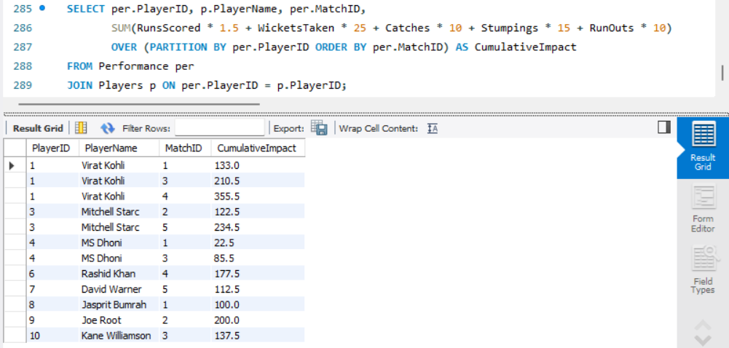
Q21.
ANSWER-21.
Explanation:
• Uses window function to calculate cumulative impact score.

Slide 22
Video Link For The Above Questions Explanation:
https://youtu.be/pZVOYRbp-Xg?si=qIRyIf8_fMOOWWI8

